Slide 1
High-throughput Serverless Tracking System
Supervisor: Dr. Thomas Heinis
Taixi Pan (tp1119), Javier Garcia (jg2121), Stefan Neamtu (sn1319), Yuang Li (yl4519), Feifan Fan (ff519)

Slide 2
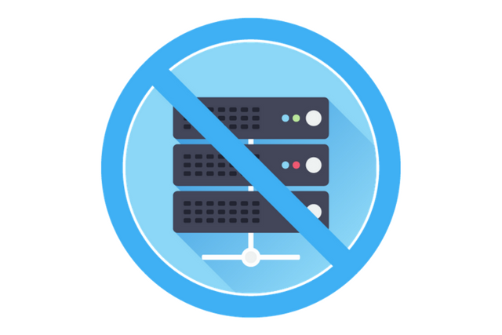
From Server-ful to Serverless
Server-ful | Serverless
Explicit management of a server. | Servers are hide away from the developers and are managed by the cloud services provider.
This Photo by Unknown Author is licensed under CC BY

Slide 3
From Server-ful to Serverless
Server-ful | Serverless
Explicit management of a server. | Servers are hide away from the developers and are managed by the cloud services provider.
Server up and running even if traffic is low. | No computational resources are used when there is no request.
This Photo by Unknown Author is licensed under CC BY

Slide 4
From Server-ful to Serverless
Server-ful | Serverless
Explicit management of a server. | Servers are hide away from the developers and are managed by the cloud services provider.
Server up and running even if traffic is low. | No computational resources are used when there is no request.
Scaling needs to be carefully tuned. | Automatic scaling managed by the cloud services provider.
This Photo by Unknown Author is licensed under CC BY

Slide 5
From Server-ful to Serverless
Code for business logic only.
Handles high concurrency automatically.
This Photo by Unknown Author is licensed under CC BY

Slide 6
Our Scenario: A Tracking System
Think about Uber or Deliveroo.
Allow the drivers/couriers to upload their location.
Allow the user to see the drivers’/couriers’ real-time location.
The system should be able to handle high loads.

Slide 7
Overview of the System

Slide 8
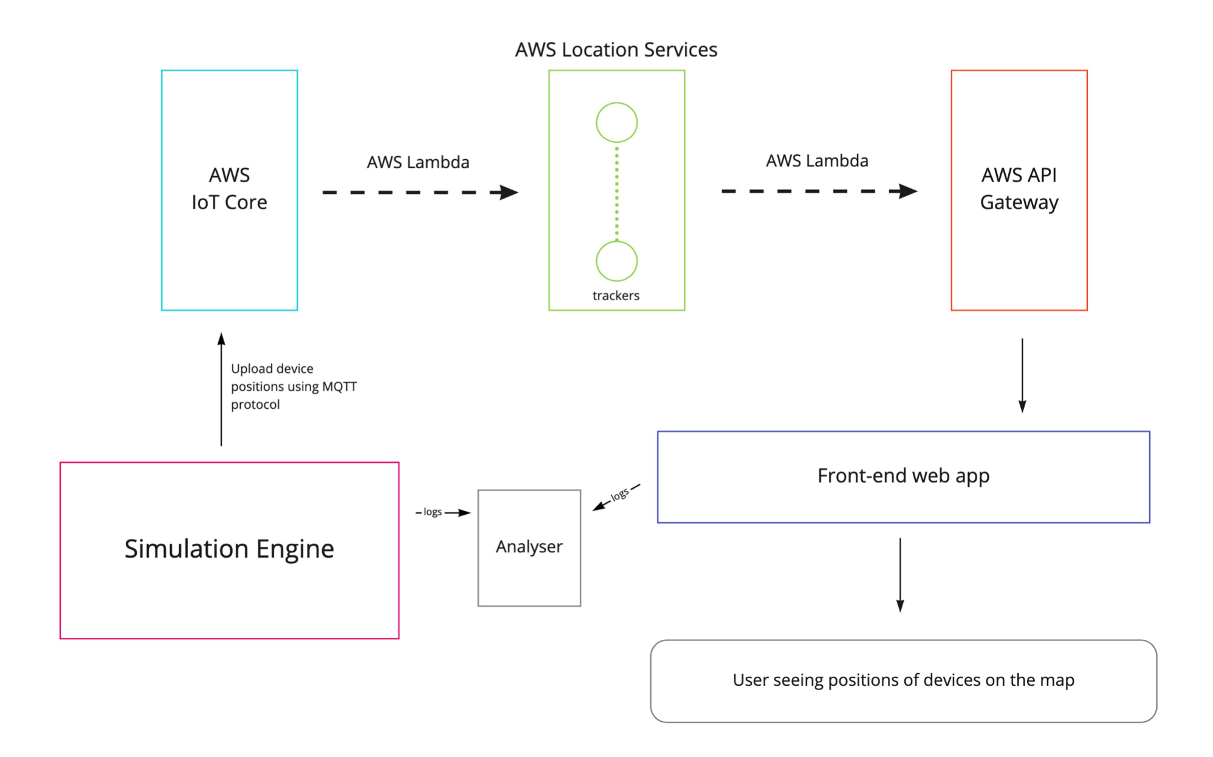

Slide 9
The Value of Our Project
Our project is valuable for those who
wish to evaluate the potential of adopting a serverless architecture
in building a delivery tracking app
that would expect a large number of users.

Slide 10
Device position upload: AWS IoT Core
Each device is treated as an IoT Thing
Device can publish messages to AWS IoT Core using MQTT protocol.

Slide 11
Device position upload: AWS IoT Core
MQTT protocol
The standard for IoT messaging.
Lightweight and efficient.
Device publish to a “topic”

Slide 12
Device position upload: AWS IoT Core
Sample MQTT message
{ "payload": { "deviceid": "AWS-1234", "timestamp": 1604940328, "location": { "lat": 49.2819, "long": -123.1187 } } }

Slide 13
Device position upload: AWS IoT Core
MQTT authentication
Device use private key and certificate to authenticate.

Slide 14
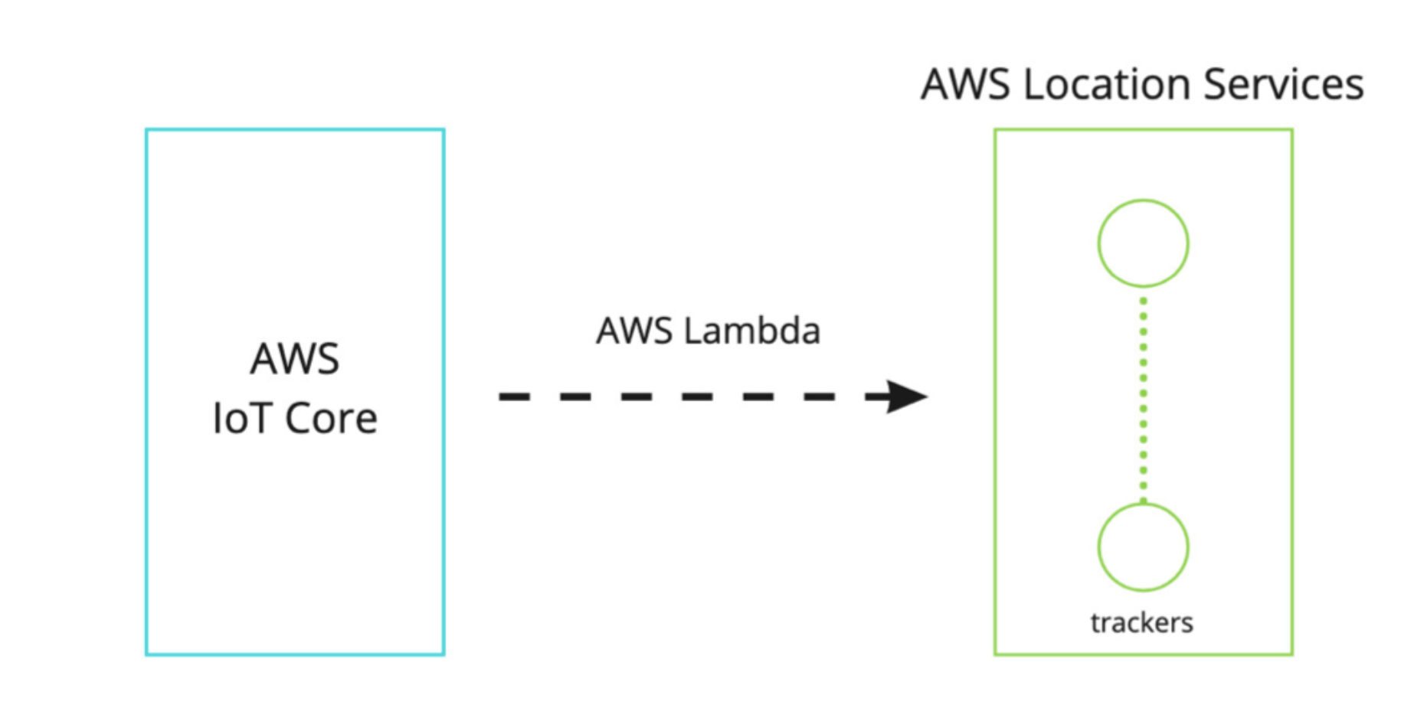
Forward messages to AWS Location Trackers

Slide 15
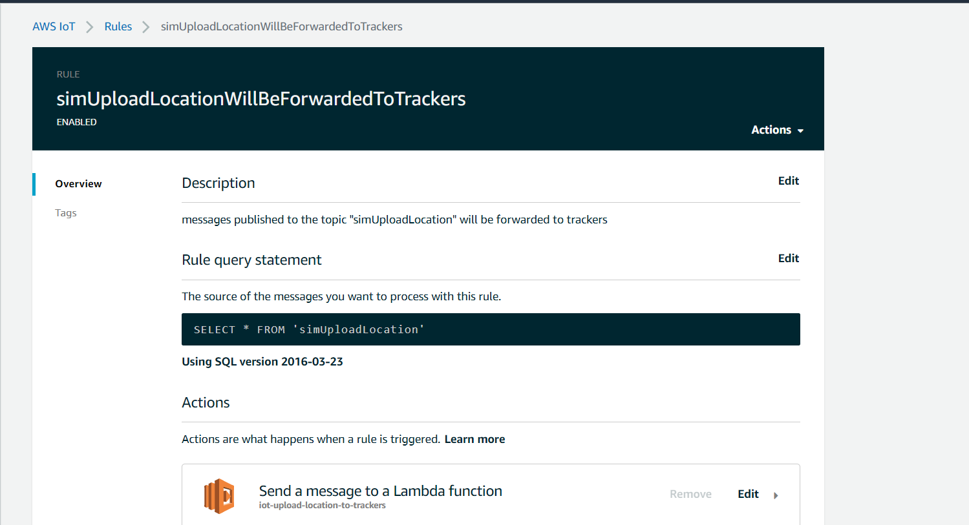
Forward messages to AWS Location Trackers
Will trigger a lambda to process the message.

Slide 16
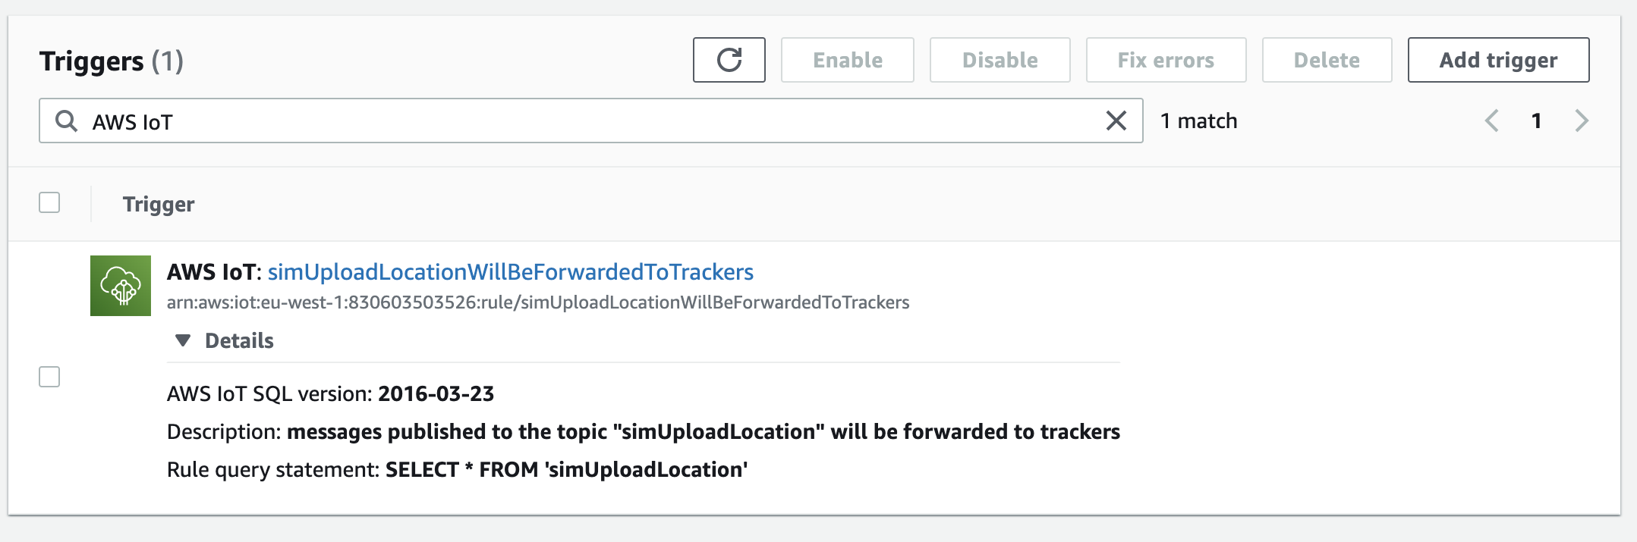
Forward messages to AWS Location Trackers
Triggered by messages published to this topic

Slide 17
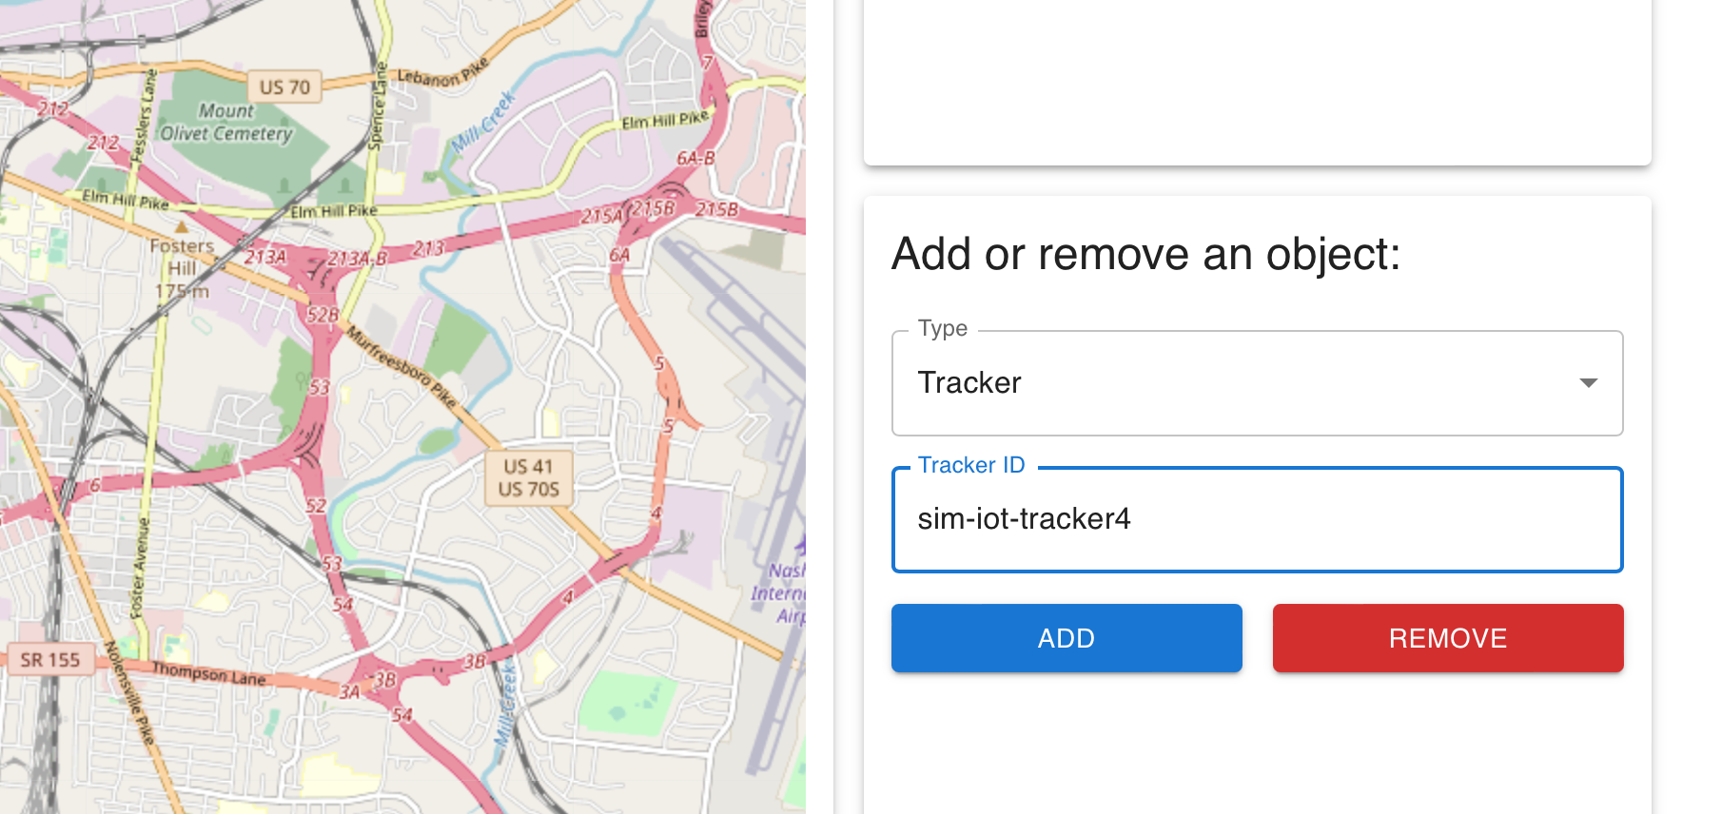
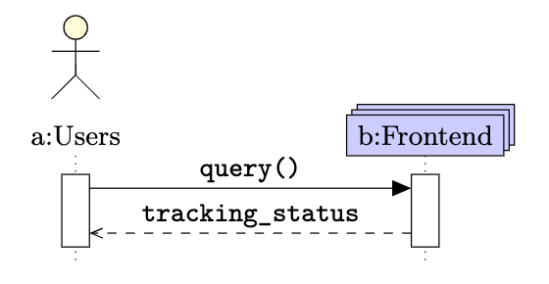
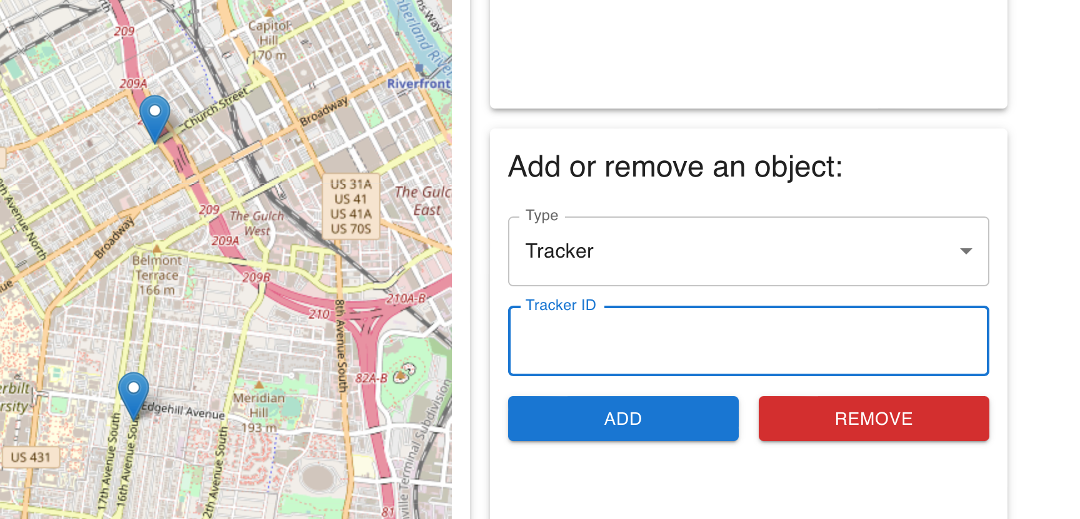
Interactive Frontend
Implementation
Abstraction

Slide 18
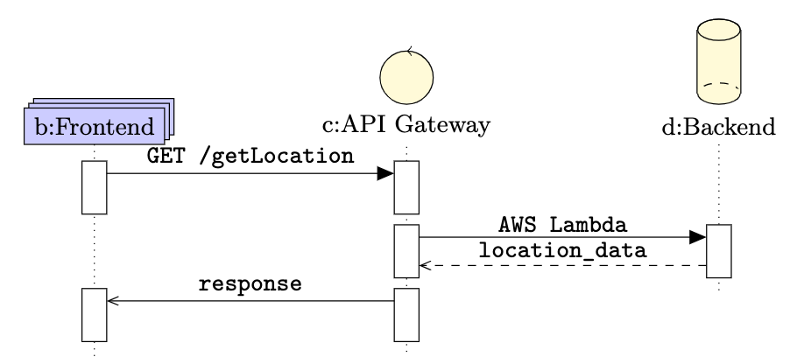
A Down-Top Abstraction
Triggers data retrieval
Handling query parameters
Get data via managing computing resources

Slide 19
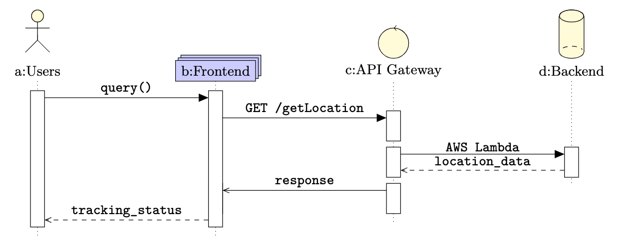
Fetch Response Pipeline at Frontend

Slide 20
Simulation engine
Tool that simulates and tests the use of our tracking system

Slide 21
Simulation engine
Tool that simulates and tests the use of our tracking system
1. Generates the necessary data

Slide 22
Simulation engine
Tool that simulates and tests the use of our tracking system
1. Generates the necessary data
2. Parses the data

Slide 23
Simulation engine
Tool that simulates and tests the use of our tracking system
1. Generates the necessary data
2. Parses the data
3. Sends the location updates

Slide 24
Simulation engine
Tool that simulates and tests the use of our tracking system
1. Generates the necessary data
2. Parses the data
3. Sends the location updates
Evaluation

Slide 25
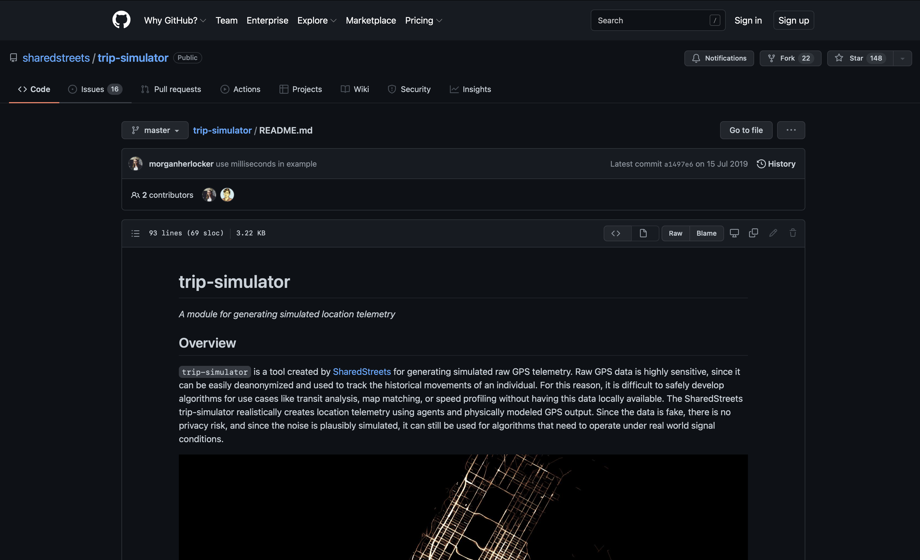
SimEng: Generating the necessary data

Slide 26

SimEng: Generating the necessary data
. . . . . . . . . .
Simulation file 1
Simulation file N

Slide 27
SimEng: Generating the necessary data
Device
IoT Thing
Needs to:
1. Be created in IoT Core
2. Be assigned a certificate
3. Be assigned two keys

Slide 28
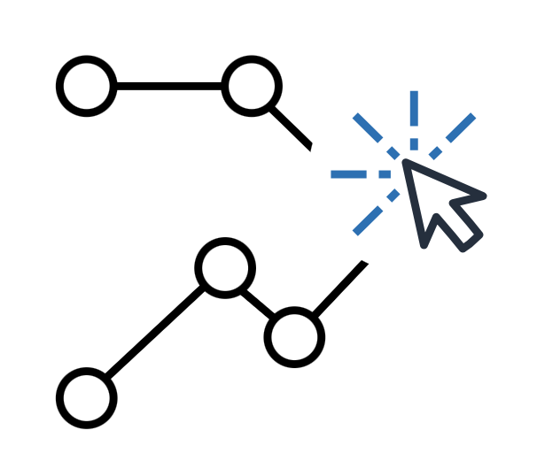
SimEng: Parsing the data, updating the offset
Time-based filter (30 seconds):
19:47:55 { DeviceID1, GPS point 1, timestamp 1}
19:47:56 { DeviceID1, GPS point 2, timestamp 1 + 7 sec.}
19:47:57 { DeviceID1, GPS point 3, timestamp 1 + 30 sec.}
Tracker

Slide 29
SimEng: Parsing the data, updating the offset
Offset (two hours, the simulated time)
Reuse sim. data and IoT Things
10 days ago
Current time

Slide 30

SimEng: Sending the location updates
Parsing, offset
Akka actors
MQTT connection
Simulation files
List of devices and their location updates
Set of devices (actors) concurrently sending the updates

Slide 31
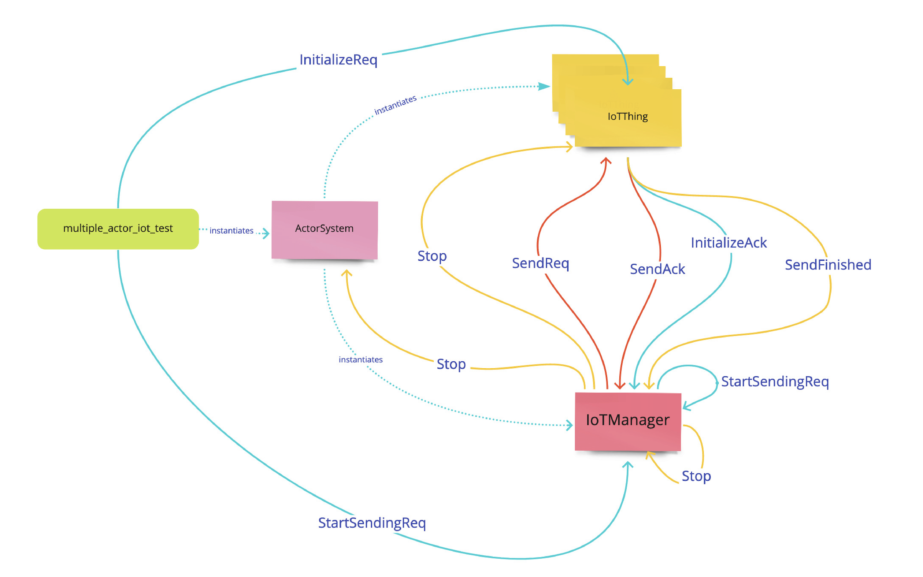
SimEng: Sending the location updates
Akka actors
IoTThing behaviour:
1. Initialization
2. Sending messages
3. Stop

Slide 32
SimEng: Evaluation
High-throughput is not a problem for our architecture and it handles well that amount of traffic
When the lambda that gets from IoTCore and publishes to the trackers scales up, it fetches some messages in a reordered way: ERROR!
Solution: Thread.sleep that forces a delay between sending two messages from potentially the same device

Slide 33
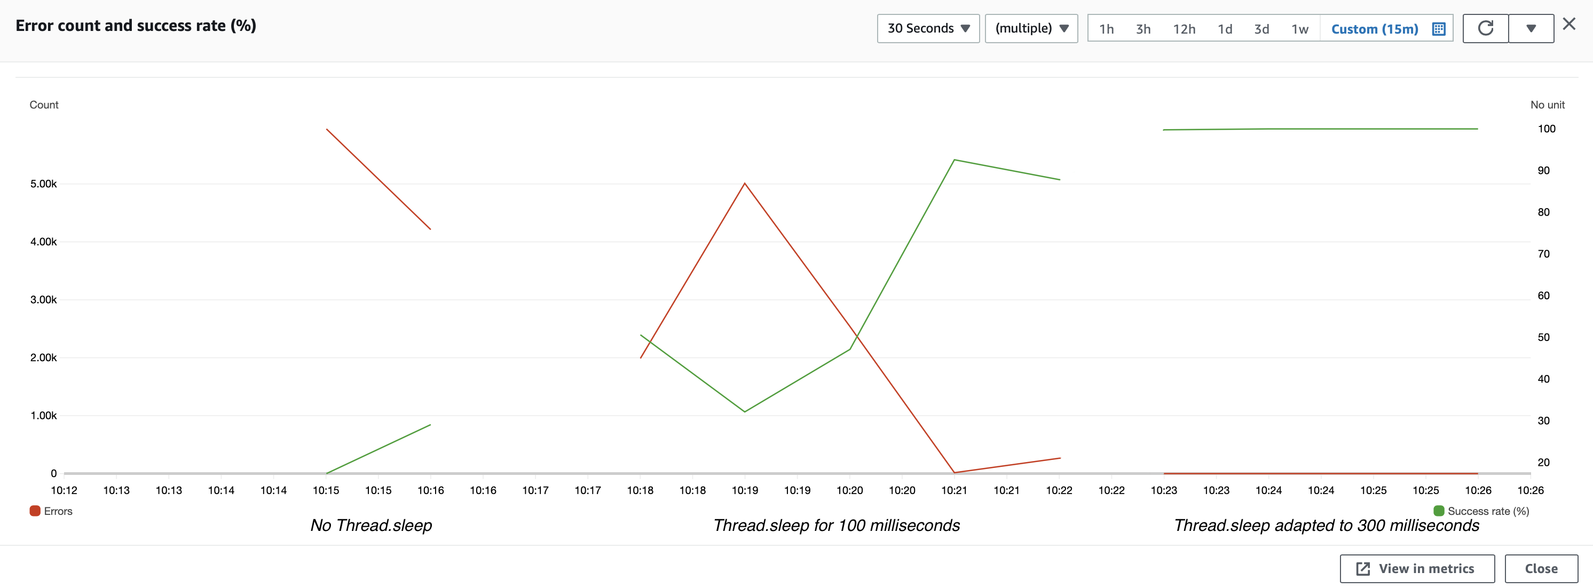
SimEng: Evaluation (30 concurrent devices)
More devices -> Less sleep time (the entire set of things has to be traversed before a same device is again sending a new location update)

